Slide 1
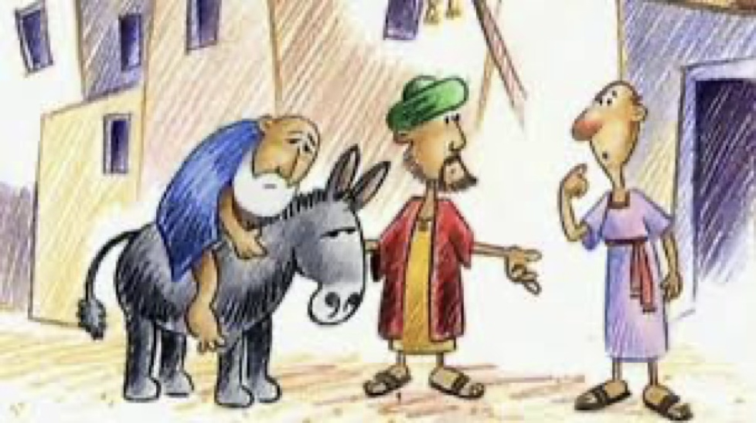


Why did Jesus Tell Stories?
LIVING
Looking at how people put their beliefs and values into action in their everyday lives and communities.
Which stories are special to us and why?

Slide 2
VOCABULARY
PRECIOUS Something of great value that we care for deeply
SPECIAL Something that is different from others and very important
COMMUNITYA group of people who share things in common
IDENTITY
The things that make us who we are

Slide 3
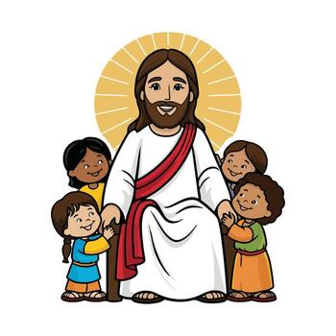
Do you remember?
In reception class we learned that Jesus is a very special person.
We also explored the story of creation.

Slide 4
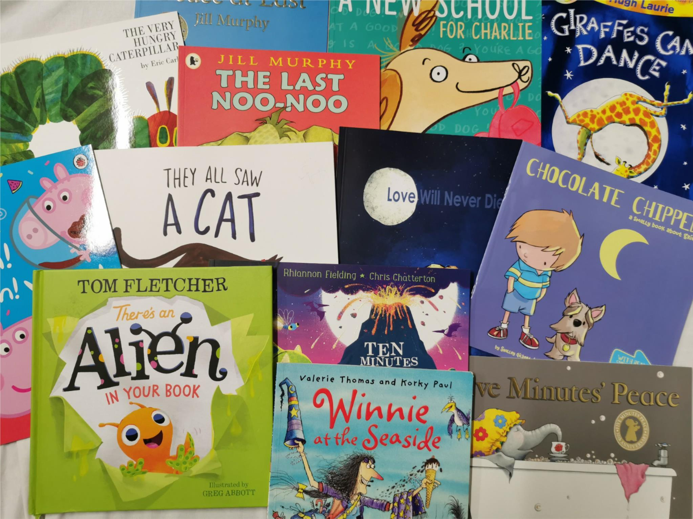
Why do we tell stories?
Since the beginning of time, people have told stories. Stories can be found in books, told by our grandparents, or even seen in films.
Some stories stay with us forever. They become a part of who we are and help us understand the world around us.

Slide 5
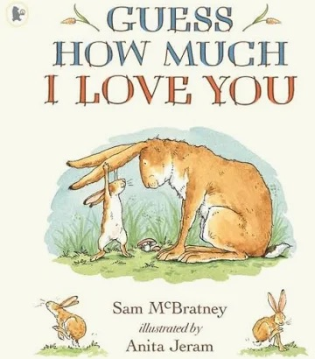
What makes a story special?
Feelings – it might make us feel happy, excited or even a little bit brave.
Lesson – it might teach us a ‘moral’ – how to be a better person.
Family – it might be a story that our family has shared for a long time.
Precious – it might be found in a book that we treat with great care.

Slide 6
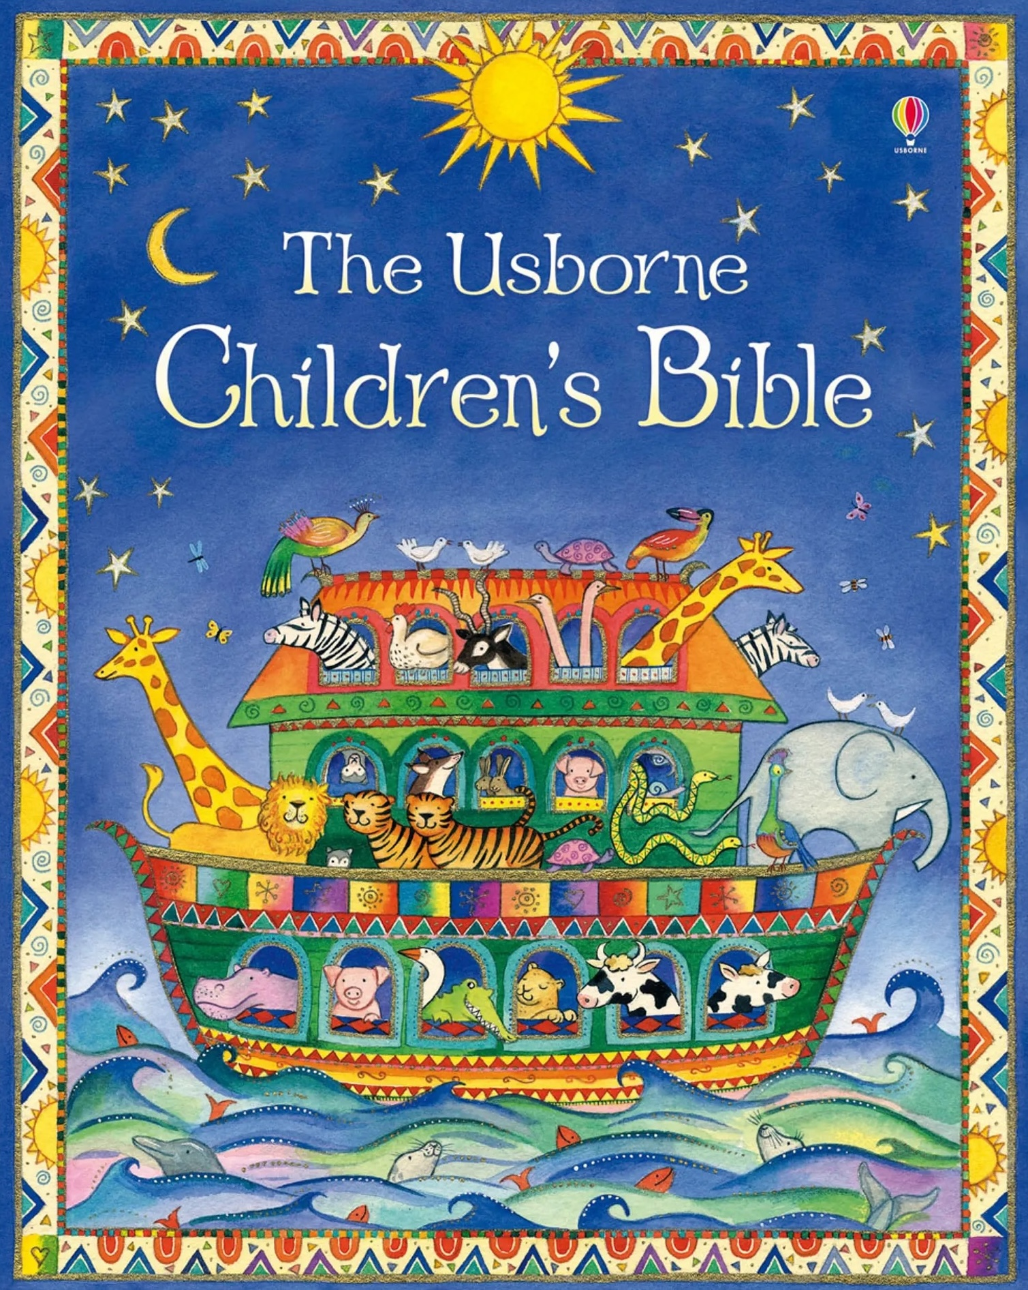
Precious Books
For Christians the Bible is a very precious book. It is filled with many different types of stories.
Christians believe these stories are ‘Good News’ (Gospel) because they teach people how to live and show God’s love.
Just like your favourite book, the Bible is special because of the messages inside it.

Slide 7

Activity – Create a story shield
2. Think of a story that is very important to you or your family.
1. Today, you are going to design your own ‘Story Shield’.
3. Divide your shield into sections to show:
Who is in the story?
Where does it happen?
What is the special message or lesson?

Slide 8

I wonder…
If a story has no pictures can it still be special?
Does a story have to be true for it to teach us something important?
Why do we share our special stories with other people?

Slide 9
Plenary
Take a look at somebody else’s story shield.
I wonder why that story is special to them?
LIVING
Looking at how people put their beliefs and values into action in their everyday lives and communities.

