Slide 1
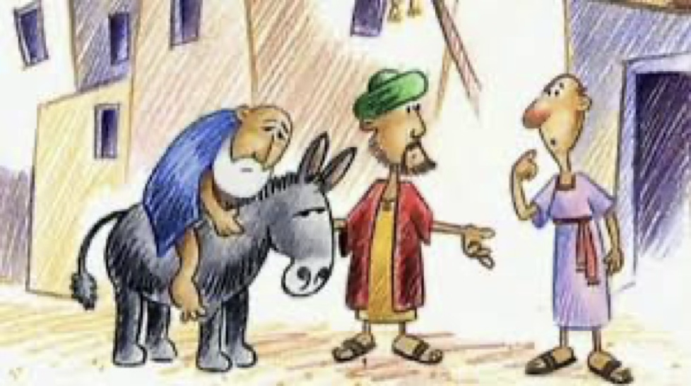


Why did Jesus Tell Stories?
BELIEVING
Finding out what people of different faiths believe, what their sacred stories mean, and how they understand their religion.

Slide 2
VOCABULARY
TEACHER
Someone who helps us learn new things
GOSPEL
The part of the Bible that tells the story
PARABLE
A special story with a deep meaning or lesson

Slide 3

Do you remember?
Last week we talked about stories that are special to us and our families.
In reception class we learned that Jesus is a very special person.

Slide 4
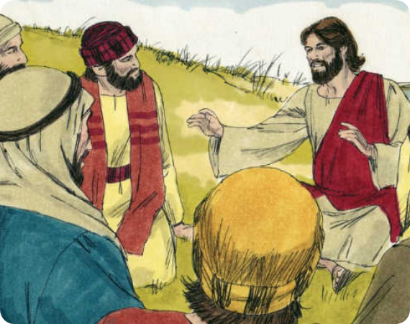
Why do we tell stories?
Jesus was a great teacher. Everywhere he went, big crowds gathered to listen to him.
He didn't just give people a list of rules. He told stories to help them understand how God wants them to live.

Slide 5
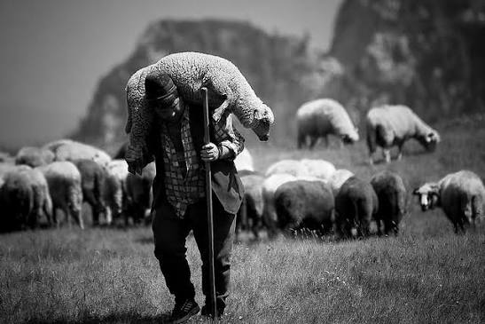
What is a parable?
The stories Jesus told are called parables.
They are earthly stories with a heavenly meaning.

Slide 6
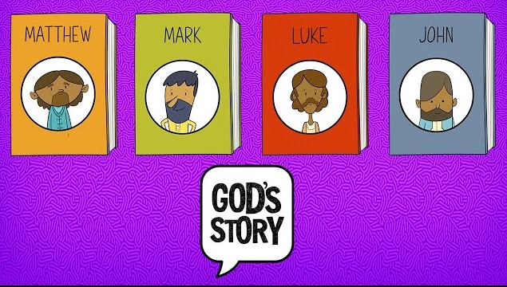
The Gospels
We find the stories Jesus told in the New Testament part of the Bible.
There are four special books called the Gospels

Slide 7
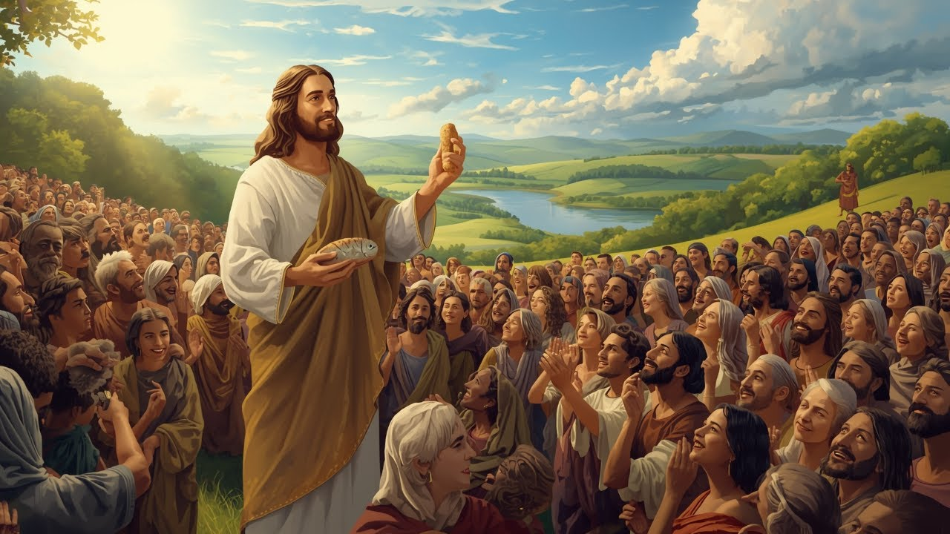
Activity – Role Play: The Gathering Crowd
We are going to pretend we are a crowd gathering on a hillside to hear Jesus.
We will handle the Bible with care and find the names of the four Gospels.
Talk to your partner: Why is it important to listen carefully to a teacher?

Slide 8

I wonder…
Why might a story be easier to remember than a list of boring rules?

Slide 9
Plenary
Gospel means ‘Good News.’ If you were listening to Jesus’ stories today, what would you want to hear?
BELIEVING
Finding out what people of different faiths believe, what their sacred stories mean, and how they understand their religion.

